Slide 1
P634-Bike Rental Regression

Slide 2
Mentor and Teammates
Team Members : Mentor :
Harsh Joshi Abisheka Kavuri
Hari
Sriram
Nihar Yekkisetti
Aditya
Ali
Jyoti Gupta

Slide 3
Objective
The objective of this business problem is to maintain a consistent availability of rental bikes in urban areas by forecasting bike demand. Ensuring a reliable supply of bikes improves public transportation convenience, reduces customer waiting time, and increases overall satisfaction. Accurate demand prediction also enables bike-sharing companies to improve operational efficiency, including managing bike distribution, optimizing pricing strategies, and planning marketing activities, while taking into account external influences such as weather conditions, seasonal variations, and holidays.

Slide 4
Exploratory Data Analysis

Slide 5
Dataset
The dataset consists of various columns including date, season, year, month, hour , holiday, weekday, working day, weather situation, temperature, normalized feeling temp,
Humidity, windspeed, count of casual user, count of registered users and the total no of users including casual and registered users.
The dataset consists of 17379 rows and 16 columns.

Slide 6
Before proceeding with EDA, we need to perform a few steps to clean the data. The required steps are :
Replacing “ ? ” with np.nan
Type Conversion of columns
Data Imputation
Drop duplicated values
We can drop instant column
Mapping 0-6 to Sunday to Saturday
Binning of hr col into morning, afternoon, evening, night
Mapping months to month names

Slide 7
Data Imputation
We have missing values in season, yr, mnth, holiday, workingday, weathersit, temp, atemp, hum, windspeed, casual and registered.
We can use fill method for missing values in yr and mnth column.
For the numeric columns, we can impute values using the median (More robust to outliers) and for the categorical columns, we can use the mode.

Slide 8
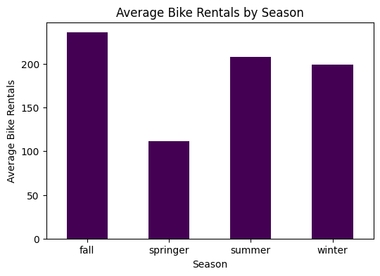
This graph reveals that the maximum no of people rent bikes in the fall, followed by summer, winter and then springer.

Slide 9
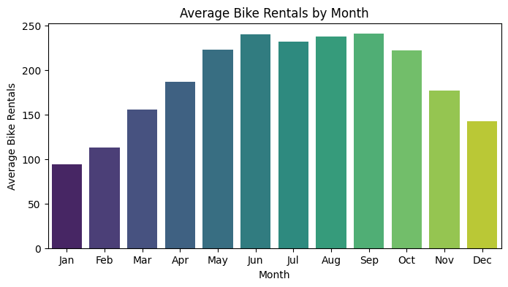
Highest number of rentals was observed in Jun and sept.

Slide 10
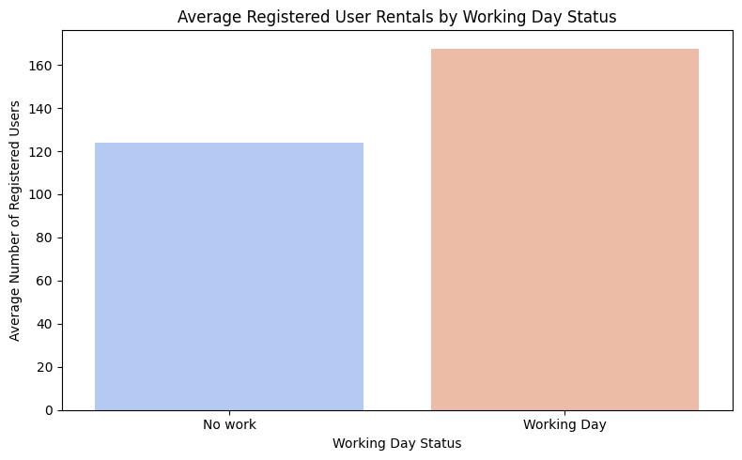
This graph reveals that many of the rentals that are registered might be used for commuting to work.

Slide 11
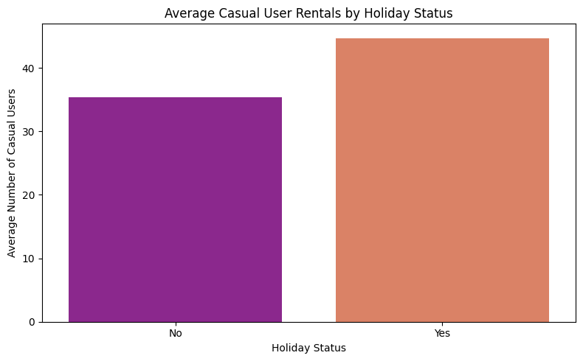
Similarly, when people have holidays , they are more likely to rent bikes casually.

Slide 12
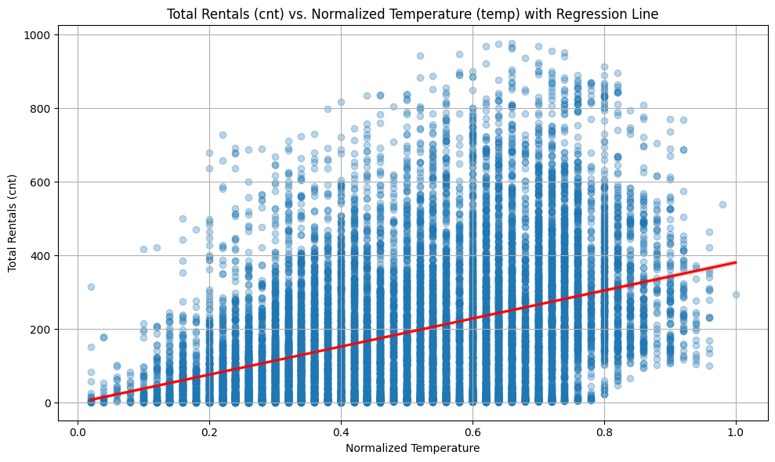
This graph reveals that as temp increases, people are more likely to rent bikes

Slide 13
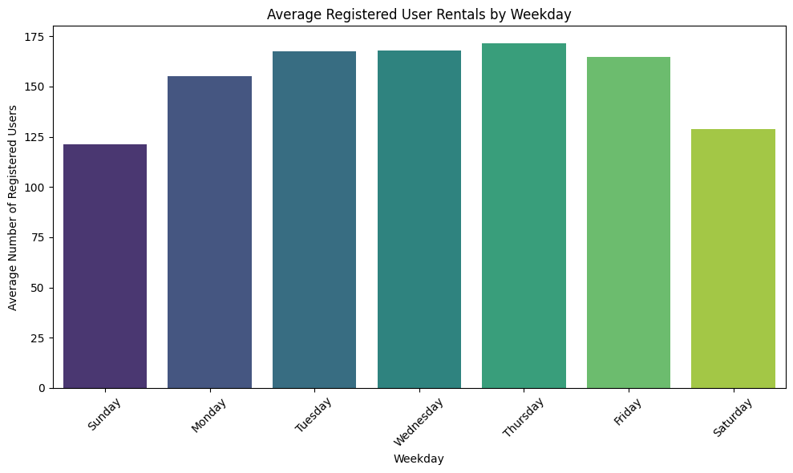
This pattern suggests that registered users primarily use bikes for commuting or work-related activities during the week

Slide 14
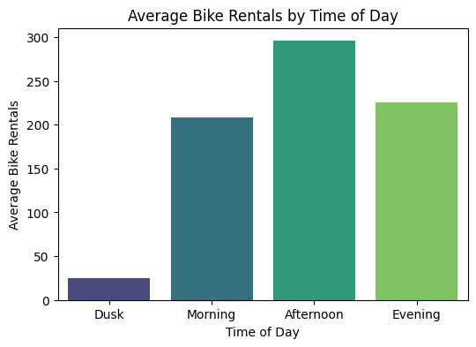
Most people rent bikes in the afternoon, morning and evening
Morning and Evening - High

Slide 15
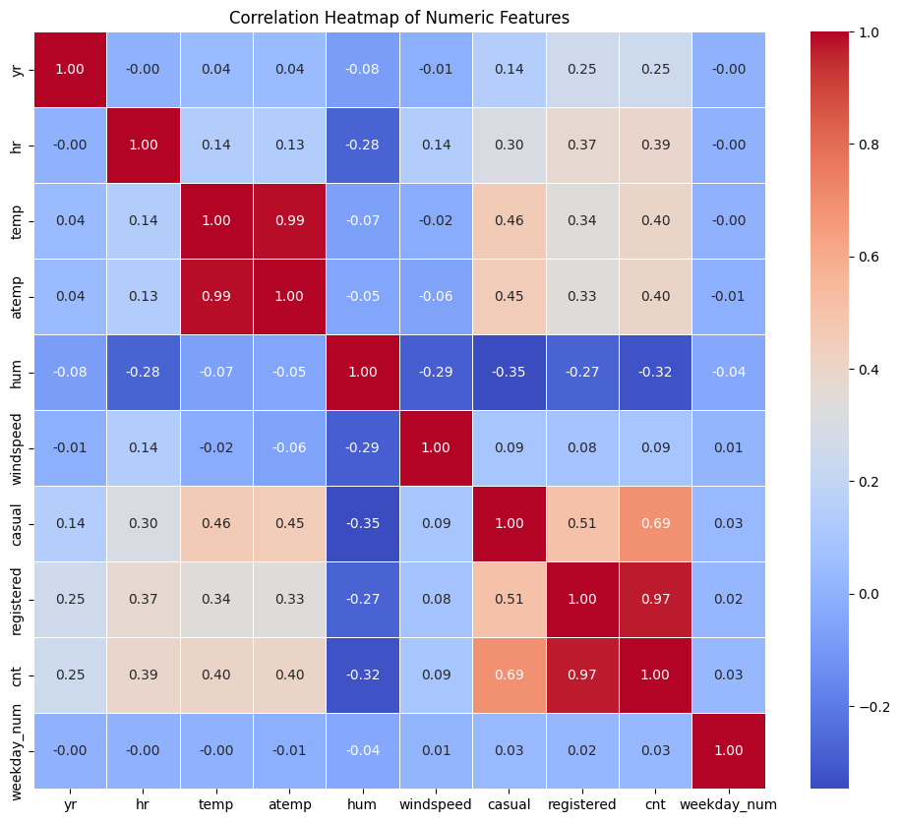
We can see that there is high corr between temp and atemp , so we can drop one column during modelling

Slide 16
Modelling

Slide 17
Modelling
For the model, we tried 3 regression models - XGBoostRegressor , RandomforestRegressor and DecisionTreeRegressor
The best result was obtained using XGBoostRegressor
The objective function was squared error
Evaluation Metrics:
R² Score
MAE
RMSE

Slide 18
XGBoostRegressor
The values for the hyperparameters for the XboostRegressor model was obtained by using GridsearchCV
The best values of the hyperparameters were :
n_estimators=700
max_depth=4
learning_rate=0.1
subsample=0.9
colsample_bytree=0.8

Slide 19
Evaluation
Using the tuned values of the hyperparameters, we were able to get the following score for different evaluation metrics
MAE – 49.93
RMSE – 72.70
R2 Score – 88%

Slide 20
Deployment

Slide 21
Deployment on Streamlit
This application is designed for deployment on Streamlit Cloud
To use the app :
Launch the application
Provide input values through the sidebar
Click the prediction button
View predicted bike rental count

Slide 22
Requirements
joblib==1.5.3
numpy==2.4.2
pandas==2.3.3
scikit-learn==1.8.0
streamlit==1.54.0
xgboost==3.1.3
Python 3.12.3

Slide 23
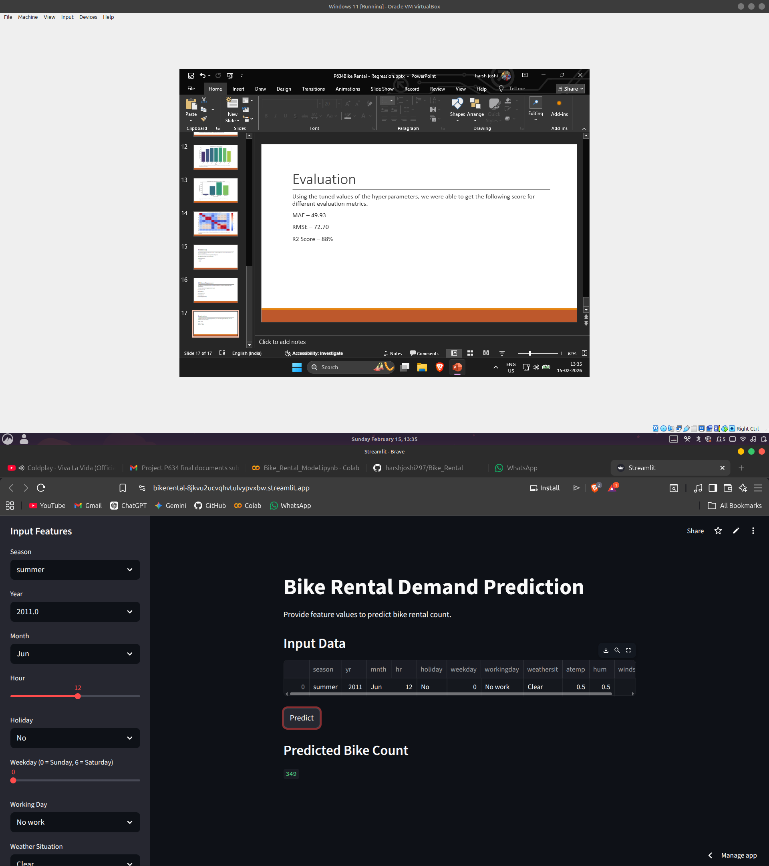

Slide 24
Challenges Faced During the Project

Slide 25
Challenges Faced During the Project
Incorrect data types (numeric columns stored as objects)
Avoiding overfitting in tree-based models
Choosing appropriate encoding for categorical features
Ensuring proper train-test split for realistic evaluation
Version mismatch between local environment and Streamlit cloud
Debugging model loading errors in production

Slide 26
Thank You!

